Slide 1
Adverse Transfusion Reaction and Complication in a Clinical Practice
Daniela Dušková
Transfusion Department of the General University Hospital in Prague and the Charles University,1.st Faculty of Medicine

Slide 2
Hemovigilance
Detection
Summary
Analysis
Notes:
Hemovigilance=a set of systematic procedures that includes the detection, summary and analysis of information on serious adverse effects and events on the part of transfusion recipients and blood donors and epidemiological surveillance.
Functional systém of reporting adverse effects of transfusion is needed.

Slide 3
Adverse reaction
Adverse reaction and complication, event, accident, mistake, associated with transfusion of blood component.
After -effect: death, life – threatening circumstances,
health damage or limitation of abilities,
admission or its prolongation, disease.
Causality!
Notes:
It is suitable to divide adverse reactions into the reactions dependended on blood component and on transfusion therapy because preventive measures are different.
We can avert some adverse reactions dependended on blood component (FNHTR, TA-GvHD, allergy..) by using its treatment (leucodepletion, X-ray, washing).

Slide 4
Adverse reaction
Mild - finishes when transfusion stops and after simple therapy
Serious – organ breakdowns, monitoring of life functions is necessary (akute haemolysis, bacterial/septic, TRALI, TA-GvHD, anaphylactic shock, post-transfusion purpura, virus, parasitic or prion transmission).

Slide 5
Averting transfusion risks
1) indication
2) choice of blood products
3) pre-transfusion controls
4) supervision of trf. administration
5) records
6) reporting adverse reaction after trf.
7) cooperation with complement ☺

Slide 6
Haemolytic transfusion reaction
Haemolysis or accelerated clearance of erythrocytes in a transfusion recipient.
Cause: immunological incompatibility between the donor and the recipient.
Notes:
With few exceptions, these reactions are caused by immunological incompatibility between the blood donor and the recipient.

Slide 7
Haemolytic transfusion reaction
ACUTE: no later than 24 hours after transfusion (intravascular haemolysis)
DELAYED: within 5 - 7 days after transfusion
(extravascular haemolysis)

Slide 8
Etiology and incidence AHTR
AB0 incompatibility
Clerical error !!!
1:30 000 transfusion
1 - 2 T.U.incomp. ery - 25% pat. +
More than 2 T.U. incomp. ery - 44% pat. +
CAVE! ONLY 30 ml of blood group „A“ to pat. „0“ CAN CAUSE DEATH !!!

Slide 9
Clerical error
A mistaken identity of blood donor
A mistaken blood donor sample
A mistaken blood group record
A mistaken labelling of blood components
A mistaken patient sample
A mistaken identity of patient
A bedside mistaken blood component

Slide 10
Checks prior to transfusion
The patient identification (NOT based on records)
Documentation accompanying blood component
Bedside check of patientś blood group and blood componentś blood group
Blood pressure, pulse, body temperature
Biological checking

Slide 11
Clinical signs of AHTR
Within receiving as little as 20 ml of AB0-incompatible red cells.
Fever.
Chills.
Pain at the infusion site or in the loin, in the abdomen, in the chest or in the head.
Hypotension.
Tachycardia.
Notes:
These may became apparent…
Initial clinical presentations include the folollowing:….
The aetiology is unclear, but may be related to rapid complement activation at the site of infusion , and the generation of bradykinin following complement activation.

Slide 12
Clinical signs of AHTR
Agitation, distress and confusion, particularly in the elderly.
Nausea or vomiting.
Dyspnoea.
Flushing.
Haemoglobinuria.

Slide 13
Clinical signs of AHTR
In anaesthetized patients, the only signs may be uncontrollable HYPOTENSION or excessive BLEEDING from the operative site, as a result of disseminated intravascular coagulation (DIC).

Slide 14
Complications of AHTR
Renal failure in up to 36% of patients.
DIC in up to 10% of patients.
Notes:
Renal failure develops in up to 36%of patients as a result of acute tubular necrosis induced by both hypotension and DIC.

Slide 15
Immediate action if you suspect AHTR
NURSE: stop transfusion, close trf. kit, maintain vein (physiological solution), call a doctor in.
DOCTOR: therapy depends on signs and clinical conditions of a patient.
Diuresis: more than 1 ml/kg/hour!
Maintain and monitor vital organ functions.
Notes:
Maintain vein – it means: keep the intravenous infusion running with normal saline.
Call doctor in – call a member of the medical staff.

Slide 16
Ensuring of patient with AHTR
Maintain adequate renal perfusion,
Repeat COAGULATION and biochemistry screens 2-4 hourly,
If diuresis falls below 1 ml/kg/hour, HEMOFILTRATION or HEMODIALYSIS is required,
DIC – therapy depends on the DICś phase.
Notes:
Maintain adequate renal perfusion by: fluid challenges and frusemide infusion - 250mg over 4 h; and if hypovolemic, dopamine infusion.
If urinary output cannot be maintained at 1 ml/kg/h, seek expert renal advice.
Haemofiltration or dialysis may be required for the acute tubular necrosis.

Slide 17
Prevention of AHTR
Perform recommended controls.
Staff training.
If an error is found, analyse the situation and prepare corrective actions to be taken to avoid future mistakes.

Slide 18
Delayed haemolytic reaction
(DHTR)
Secondary immune responses following re-exposure to a given red cell antigen.
The recipient has been primarily exposed in pregnancy or as a result of a previous transfusion.
DHTR – is rarely fatal.
Notes:
With few exceptions DHTRs are due to: see a slide..
DHTR is rarely fatal, although in asociation with the underlying disease can lead to mortality.

Slide 19
DHTR – Case Report
Patient O.G., born in 1968
On the 9th day after the operative revision transfer from the surgical clinic to the internal clinic.
Jaundice of unclear etiology.
Anemization.
Elevated bilirubin value.

Slide 20
Results
USG - no organic reason of icterus
Hepatitis - serological screening negative
Hematology- HB 103 g/l - 74 g/l
- retikulocytes 31,40%
- coagulation - OK

Slide 21
Results
Biochemistry- bilirubin 154 umol/l
- conjugated bilirubin 131 umol/l
- haptoglobin 0,06 g/l
- LD 10,8 ukat/l
- urea OK
- creatinine OK
URINE - bilirubin 70 umol/l

Slide 22
IMUNOHEMATOLOGY
DAT positive
IgG erythrocytes opsonization
Titer IgG 1000 (+/-); 300 (1+)
Titer IgG1 100 (1+)
Screening alloanibodies POSITIVE

Slide 23
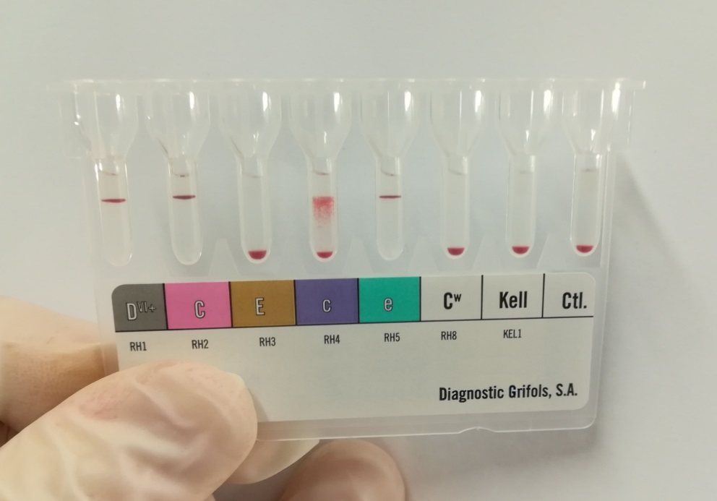
Pacient: D pos., CCee, Cw neg., Kell neg.

Slide 24
Alloantibody Identification
Anti-c

Slide 25
Analysis
Pacient, female O.G., nar. 1968
Admission for observation to surgical clinic due subileus
Revision: three perforation, diffuse mild bleeding from adhesions.. ..coagulation disorder
CAVE: no evidence for surgical reason of bleeding

Slide 26
Analysis
Indication for blood products administration perioperativelly .
Results of laboratory pretransfusion measures:
AB RhD posit.,
Screening alloantibodies negative.

Slide 27
Blood products-erythrocytes
EBR Ccee,Cw neg., Kell pozit.
EBR Ccee, Cw neg., Kell neg.
ERD ccee, Cw neg., Kell neg.
ERD Ccee, Cw neg.,Kell neg.
EBR Ccee, Cw neg.,Kell neg.
ERD CCee, Cw neg., Kell neg.
ERD CCee, Cw neg.,Kell neg.
ERD Ccee, Cw neg.,Kell neg.
FFP: 6 TU

Slide 28
From health history
APE
Few revision of abdominal cavity because of adhesions and ileus
Pregnancy – sectio caesarea
Ovarectomia bilateralis
1x TRANSFUSION of ERYTHROCYTES

Slide 29
Outcome and Mission
Delayted hemolytic transfusion reaction
CAVE: health history
CAVE: anamnestic alloantibodies with very low titer

Slide 30
Delayted haemolytic reaction
(DHTR)
Secondary immune responses following re-exposure to a given red cell antigen.
The recipient has been primarily exposed in pregnancy or as a result of a previous transfusion.
DHTR- is rarely fatal.

Slide 31
Clinical signs of DHTR
Usually within 5-10 days after transfusion, but intervals can vary.
Fever.
Fall in haemoglobin concentration.
Jaundice and hemoglobinuria.
(Renal failure in up to 6% of cases).

Slide 32
Therapy of DHTR
Symptomatic:
A) Maintain vital functions
B) Diuresis

Slide 33
Prevention of DHTR
Complete compatibility testing
Health history: pregnancy, transfusion!
CAVE: anamnestic alloantibodies with very low titer!

Slide 34
HTR - conclusion
Cause of immediate morbidity and mortality following a transfusion.
Clinical signs – diverse and they can be unrecognized or misdiagnosed.

Slide 35
FNHTR
The most often transfusion reaction.
Febrile episode (body temperature rises by 1°C during or soon after transfusion and there is no another obvious cause such a haemolytic transfusion reaction).
The mildest reaction, patients have fever, but otherwise they are asymptomatic. Body temperature usually drops after 2-12 hours after disconnection of transfusion.
Notes:
Vyskytuje se nejčastěji u polytransfundovaných pacientů s přítomnými antileukocytárními protilátkami (hl. anti-HLA protilátkami).

Slide 36
FNHTR
Etiology:
Recipients´HLA antibodies
x
blood components´HLA Ag
Cytokines (IL-1 beta, IL-6, IL-8, RANTES)
Notes:
Anti-HLA protilátky příjemce reagují s HLA antigeny , které jsou přítomny na povrchu buněčných membrán buněk obsažených v TP.
V zemích s celoplošnou 100% deleukotizací TP – incidence FNHTR méně než 0,1%.
RANTES=protein. It is a selective attractant for memory T lymphocytes and monocytes. It binds to CCR5, a coreceptor of HIV. RANTES is an acronym for Regulated on Activation, Normal T Expressed and Secreted. It is also known as CCL5.
CCL5 is an 8kDa protein classified as a chemotactic cytokine or chemokine. CCL5 is chemotactic for T cells, eosinophils, and basophils, and plays an active role in recruiting leukocytes into inflammatory sites. With the help of particular cytokines (i.e., IL-2 and IFN-γ) that are released by T cells, CCL5 also induces the proliferation and activation of certain natural-killer (NK) cells to form CHAK (CC-Chemokine-activated killer) cells.^{[2]} It is also an HIV-suppressive factor released from CD8+ T cells. This chemokine has been localized to chromosome 17 in humans.^{[1]}
RANTES was first identified in a search for genes expressed "late" (3–5 days) after T cell activation. It was subsequently determined to be a CC chemokine and expressed in more than 100 human diseases. RANTES expression is regulated in T lymphocytes by Kruppel like factor 13 (KLF13).^{[3][4][5][6]} RANTES, along with the related chemokines MIP-1alpha and MIP-1beta, has been identified as a natural HIV-suppressive factor secreted by activated CD8+ T cells and other immune cells.^{[7]} Recently, the RANTES protein has been engineered for in vivo production by Lactobacillus bacteria, and this solution is being developed into a possible HIV entry-inhibiting topical microbicide

Slide 37
FNHTR
Clinical signs:
Fever without haemolysis (BT over 38°C or rises by 1°C), flushing, tachykardia, sometimes chills, shivers- usually occur about 30 mins to 2 h after the start of a red cell transfusion, and even earlier after a platelet transfusion.
Dif.dg.: AHTR, bacterial contamination of the unit should also be suspected.
Notes:
Až do 4 hodin po transfuzi.

Slide 38
FNHTR
Therapy:
Administration of antipyretics in repeated reactions.
Prevention:
Leucodepleted blood products.
Notes:
Hypotenzní reakce u příjemce: aktivace bradykininu na deleukotizačním filtru (vzhledem ke krátkému poločasu bradykininu reakce nehrozí při in- line deleukotizaci).

Slide 39
TRALI –A CASE REPORT
A 25 year old female suffered a broken femur in a car accident, subsequently underwent surgery the next day and received 2 units of red cells intraoperatively.
Patient was extubated after adequate spontaneous ventilation was established. Approximately 3 hours after transfusion and 15 mins after extubation, patients´ respiratory rate increased from 12 to 32 breaths per minute. Her temperature rose from 36.7 to 38.7°C. Her blood pressure dropped from 120/70 to 101/74; oxygen saturation dropped from 100% to 90%; her chest x-ray showed severe pulmonary edema.

Slide 40
TRALI –A CASE REPORT
Patient had hypoxemia and oxygen saturation was not maintained above 90% with O₂ supplementation and patient was reintubated.

Slide 41
TRALI –A CASE REPORT
A differential diagnosis:
pulmonary/fat embolism,
aspiration pneumonitis,
pulmonary edema,
fluid overload,
ARDS,
TRALI.

Slide 42
TRALI –A CASE REPORT
Chest X-ray showed massive pulmonary congestion with diffuse infiltrates.
By postoperative day two, chest X-ray became clear and patient was weaned and extubated.
Laboratory studies at the blood transfusion service confirmed the diagnosis of TRALI at a later day.

Slide 43
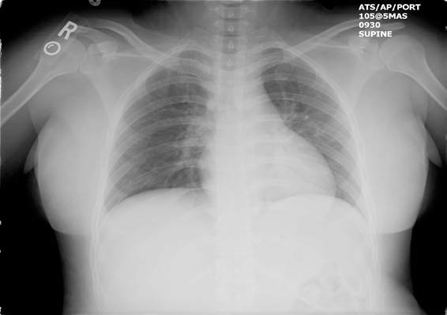
Pre-transfusion X-ray picture

Slide 44
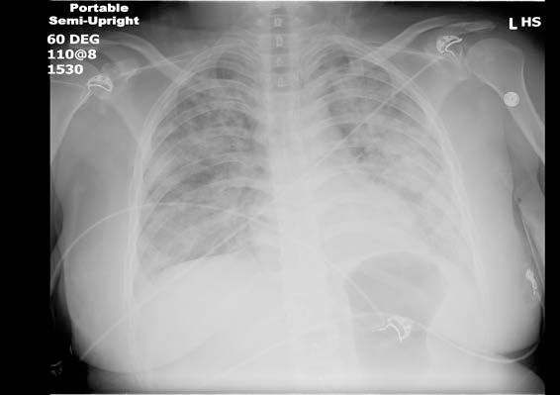
Post transfusion X-ray picture

Slide 45
TRALI
TRALI =
= transfusion related acute lung injury
- a serious acute lung reaction
- transfusion of blood component containing donors´plasma

Slide 46
TRALI
Clinical signs:
Acute respiratory insufficiency (within 6 hours after starting of a transfusion),
hypoxemia,
fever +bilateral lung infiltrate with pulmonary edema
Clinical diagnosis:
Bilateral lung infiltrate with pulmonary edema

Slide 47
TRALI
TRALI – THERAPY:
Maintaining of vital function!
PREVENTION: plasma free blood products

Slide 48
TRALI
Etiology:
Specific HLA antibodies
Granulocyte antibodies
Lipids with a biological activity
Notes:
Přítomné v plazmě dárce, reagují s leukocyty příjemce, vzácněji mohou reagovat protilátky v plazmě příjemce s leukocyty dárce.

Slide 49
TRALI
Clinical improvement in 48-96 hours
Lung infiltrates disappear within 1-4 days
Mortality 5%
Prevention: plasma free blood products

Slide 50
Urticarial and anaphylactic reactions
URTICARIA
recipient has plasma proteins antibodies.
ANAPHYLAXIS
recipient has IgA deficiency/absence IgA,
(recipient has IgA antibodies),
recipient or donor is an allergic person.

Slide 51
Urticarial and anaphylactic reactions –clinical signs
1. Non – systemic: focal urticaria , angioedema
2. Mild systemic – chest tightness, wheeze, generalized urticaria/angioedema
3. Moderate systemic-wheeze, breathlessness, obstructive laryngeal oedema
4. Anaphylaxis – severe difficulty with breathing, shock, arrythmia, loss of consciouness.

Slide 52
Urticarial and anaphylactic reactions
Therapy: transfusion to be stopped immediatelly,
Antihistaminics, steroids
Prevention: washed blood products
plasma ?
Notes:
Po ustoupení symptomů lze v transfuzi pokračovat (cca za 15-3 minut), detailní vyšetření není nutné.

Slide 53
Anaphylaxis
HYPOTENSION
Erythema
Dyspnea
Stridor
Angioedema
Generalized pruritus
Hives
Notes:
Symptomy se objeví pouze po prvních několika ml transfuze, během transfuze nebo do 24 hodin.

Slide 54
Anaphylaxis
acute shortness of breath
HYPOTENSION – loss of consciouness
(obstructive laryngeal oedema)
Notes:
Hypotenze se ztrátou vědomí během transfuze bez nálezu jiné příčiny

Slide 55
Anaphylaxis - therapy
1. stop transfusion, maintain vein
2. maintaining of vital functions
3. treatment of allergic manifestations
4. anti-shock measures

Slide 56
Anaphylaxis - prevention
Ig A deficit plasma
Washed blood products
Notes:
Jedinci s IgA deficitem – autologní TP před plánovanými výkony.
Promyté TP:obsah proteinů ve finálním supernatantu je méně než 0,5 g/TU.

Slide 57
Bacterial contamination
Clinical signs:
fever (BT>2°C),
chills, shivers,
nausea, vomiting,
HYPOTENSION, collapse, shock,
DIC, intravascular haemolysis,
renal failure.

Slide 58
Bacterial contamination
Yersinia..Serratia..(ERYTHROCYTES)
Staphylococcus..Enterobacterie..
(PLATELETS)
Notes:
Vyskytuje se zřídka, ale pokud se vyskytne, je život ohrožující.

Slide 59
Bacterial contamination
Primary
Secondary

Slide 60
Bacterial contamination
THERAPY:
1. Stop the transfusion!
(retain all packs for investigation)
2. Symptomatic therapy – perform general supportive treatment
(maintain vital functions and diuresis)
3. Give broad-spectrum ATB until the results of blood cultures are known.
Notes:
Hypotenze: roztoky : volumoexpandery, vasopressory (DOPAMIN)

Slide 61
TA-GvHD
Immunologically competent allogenic T-lymphocytes in severely immunocompromised recipient.
Clinical signs are similar to classic GvHD.

Slide 62
Blood products with a high risk of TA-GvHD
1. GRANULOCYTES
2. Blood products with identical HLA haplotype
Notes:
Granulocyty jsou kontaminovány vysokým počtem lymfocytů, jsou ozařovány pro všechny příjemce;HLA shodný haplotyp – ozáření všech komponent, pokud je podání mezi rodinnými příslušníky.

Slide 63
TA-GvHD - prevention
Gamma irradiation of celular blood products with 25 Gy.

Slide 64
Transmission of infectious diseases
Viruses, bacteria, protozoa, prions..
Any infectious agent present in the donorś blood stream at the time of collection or any infectious agent with which blood was contaminated during collection or processing.
Notes:
Priony: Přenos klasické CJD ať sporadické nebo iatrogenní formy krevní transfuzí nebyl prokázán, přesto jsou zdárcovství vyřazovány osoby(CJD v příbuzenstvu, léčba tkáněmi a přípravky lidského původu (tvrdá plena mozková, rohovka, růstový hormon z hypofýzy). Variantní forma (vCJD) – přenos alimentární cestou z hovězího dobytka na člověka přenosné transfuzí je. Byly popsány nejméně 3 případy, vyřazování dárců – pobyt v GB + Francii v letech 1980-1996 déle než 6 měsíců+ transfuze v minulosti v GB.

Slide 65
Transfusion – induced circulatory overload - TACO
Very rapid or large volume transfusions leading to acute hypervolemia.
Newborns, children and patients over 60 years of age.
Cough, shortness of breath, cyanosis, headache, tachycardia, cardiac failure.
Transfusion 1 ml/kg/hod
Notes:
TACO- Transfusion Associated Circulatory Overload

Slide 66
Outcome
Check transfusion.
Report adverse reactions.
Reporting is important for a quality of hemotherapy!

Slide 67
Outcome 2
The safest transfusion is not administered one!

